Slide 1


Compliant Cloud+Campus
Hybrid HPC Infrastructure
Brenden Judson
Dept. of Computer Science
University of Notre Dame
bjudson1@nd.edu
Matt Vander Werf
Center for Research Computing
University of Notre Dame
mvanderw@nd.edu
Paul Brenner
Center for Research Computing
University of Notre Dame
pbrenne1@nd.edu
Notes:
compliant = CUI (in this case)

Slide 2

What is CUI?
CUI stands for Controlled Unclassified Information
NIST SP 800-171
Rev. 1 came out in 2016
Outlined the regulation standards for CUI data held in non-federal IT infrastructure
110 requirement controls in 14 different categories
CUI compliance required for many DOD or DARPA federal grants and by other federal agencies
Focus is only on protecting confidentiality of CUI data
Notes:
NIST -> National Institute of Standards and Technology
SP -> Special Publication
Derived from FISMA Moderate requirements; goal was to simplify and eliminate unnecessary and non-applicable FISMA 800-53 controls for non-federal organizations
Security controls dealing with data availability and data integrity are not included in/required for CUI compliance

Slide 3
What is CUI?
Indicated by the inclusion of the DFARS 252.204-7012 clause in the contract for a DOD or DARPA funded grant
Accompanied by a Limited Dissemination Control designation [1], which indicates who should be able to have access to the CUI data
May be considered ITAR, EAR, etc. alongside CUI
Came into force on January 1, 2018
[1] https://www.archives.gov/cui/registry/limited-dissemination
Notes:
Example designations are NOFORN (restricted to U.S. Citizens only) and DL ONLY or Dissemination List Only, meaning it is up to the grant manager(??) to determine who is allowed access to the CUI data
DFARS -> Defense Federal Acquisition Regulation Supplement
ITAR -> International Traffic in Arms Regulations
EAR -> Export Administration Regulations

Slide 4
CUI at ND
Multiple recent federal grants requiring CUI compliance
Mostly DARPA and DOD grants
One group with these grants is the Notre Dame Turbomachinery Laboratory (NDTL)
Requires HPC environment (CRC responsibility)
Cloud or on-premise?
Notes:
HPC here means use of an interconnect like Infiniband for highly parallel jobs over many tightly-coupled cores and systems
typical of top-tier HPC centers operated by many academic and government research institutions, including at Notre Dame

Slide 5
Cloud Benefits
Less regulation requirements to manage (taken care of by cloud vendor)
More elastic and scalable than on-prem resources
Newer, more powerful individual servers than in the average on-prem HPC environment
Doesn’t require such large capital investments typical of large on-prem HPC purchases
Notes:
AWS GovCloud, Azure Government, and GCP for Government are all already CUI and FedRAMP Moderate compliant, required for CUI compliance for DOD or DARPA funded grants, as well as FISMA compliant. AWS GovCloud and Azure are also DFARS compliant.

Slide 6
Cloud Downsides
All three major cloud vendors (AWS, Azure, GCP) all claim to support HPC
But no cost-effective support for true, top-tier HPC workloads
HPC typically requires much higher utilization rates than enterprise or general IT systems
HPC is significantly more expensive in the cloud than other IT segments
Notes:
Not cost effective for Notre Dame
Typical of top-tier HPC centers operated by many academic and government research institutions, including at Notre Dame

Slide 7
Cloud Downsides
No cost-effective high-speed interconnect offerings, like InfiniBand
Azure is the only major vendor that offers InfiniBand, but it isn’t cost-effective
Low latency, fast network performance is a major concern for true, top-tier HPC in the cloud
No readily available high performance file storage like Lustre or Panasas
Notes:
Not cost effective for Notre Dame
...readily available in a cloud service, similar to S3 and EBC in AWS
highly parallel jobs over many cores and systems, typical of top-tier HPC environments and workloads
typical of top-tier HPC centers operated by many academic and government research institutions, including at Notre Dame

Slide 8

Hybrid Approach
Decision was made to implement a hybrid CUI environment for the NDTL group
Takes advantage of the benefits of the cloud while performing true HPC in an on-campus data center
Notre Dame already uses commercial AWS; AWS GovCloud is used for cloud CUI environment
Collaboration with ND Office of Information Technology (OIT) and Engineering & Science Computing (ESC) groups and the CRC
Notes:
ESC does desktop and computing lab support for Engineering and Science departments

Slide 9
System Architecture Diagram
http://www.crc.nd.edu/~mvanderw/crc_cui.pdf

Slide 10
Client Facing
Users/administrators use Ericom Connect software to access ND CUI GovCloud environment
Uses separate CUI environment-specific Active Directory (AD) domain for authentication
Web, desktop, or mobile application interface
Duo is used for 2FA
Provides an interface for users to log into various workstations in different projects in the GovCloud CUI environment
Users get a desktop for a Windows or Linux workstation through an RDP connection via Ericom

Slide 11
Shared Services
Managed by ND OIT group
Isolated AWS VPC; peers with all project VPCs
Designed and implemented over the course of 2 years; production since January 2018
Offers shared infrastructure services to project VPCs and on-campus CUI environment
DNS, AD, Windows Update, Red Hat Satellite server, Ericom Connect server, etc.
All inbound & outbound traffic between campus, GovCloud CUI environments and the outside world must go through Shared Services
Notes:
VPC -> Virtual Private Cloud

Slide 12
NDTL Project VPC
Managed by ND ESC and OIT
Production since January 2018
Contains user workstations for the NDTL group
Used for small computational models and graphics-intensive data analysis
Also used to access the on-campus CUI HPC environment
Other non-hybrid project VPCs also exist in ND AWS GovCloud environment
Notes:
There are also other project VPCs that exist that are not hybrid like for the NDTL project, but this paper/presentation is specifically regarding the hybrid NDTL/Turbo project environment

Slide 13
CUI HPC Infrastructure
Managed by CRC; resides in CRC data center
Systems enclosed in two locked racks only accessible via special RFID proximity access cards, using an APC NetBotz rack monitoring appliance
HPE DL385 Gen10 systems running AMD EPYC processors
20 compute nodes + 1 interactive frontend
10 Gb Ethernet, Mellanox EDR InfiniBand interconnect
Notes:
TOR Cisco network switch between the two racks
(if skipping slide after pictures)
NFS server for scratch space used for HPC jobs; persistent storage only exists in AWS GovCloud environment
separate xcat server for provisioning and UGE server for job scheduler
Also includes other administrative/infrastructure services, some to help fulfill CUI requirements
log aggregation server (Graylog), Tripwire change monitoring server, etc.

Slide 14
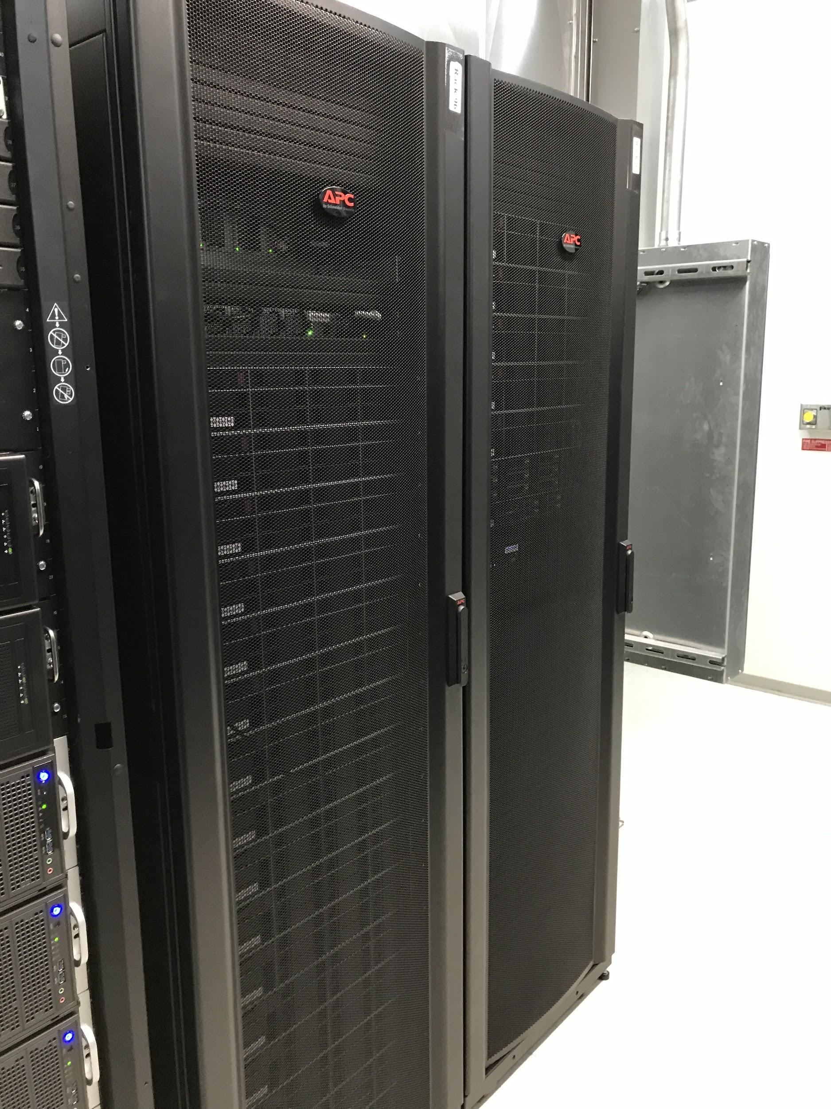
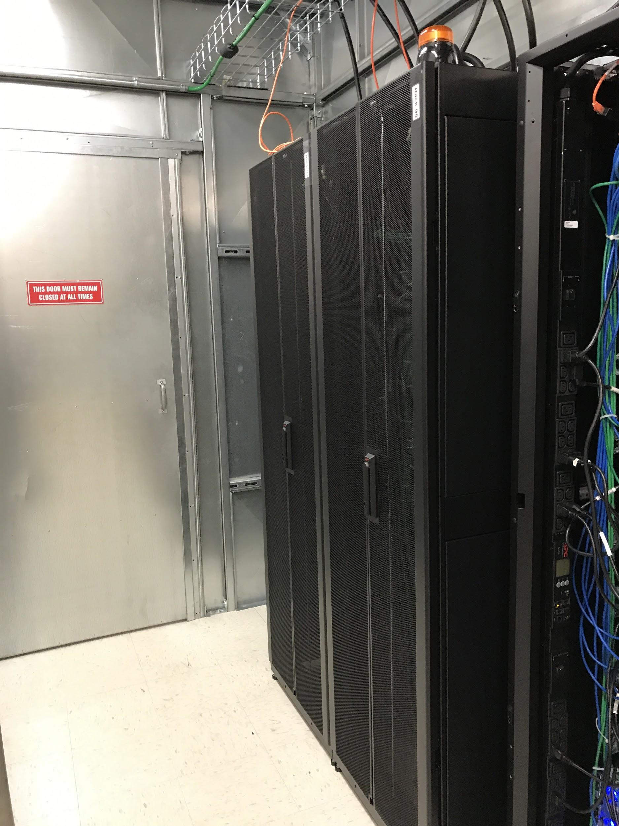
Notes:
doors are not normal for us (restricts air flow)
racks locked together; brushes between racks allows for cable flow between racks
sensors go to door and handle; can indicate when the door is unlocked and/or is open
leaves audit trail of whenever someone accesses the racks
proximity cards tied to individual people so you can see who accessed the racks, at what times
….all important for CUI compliance
alerts can be sent out by NetBotz for unauthorized access or other obnomilies

Slide 15
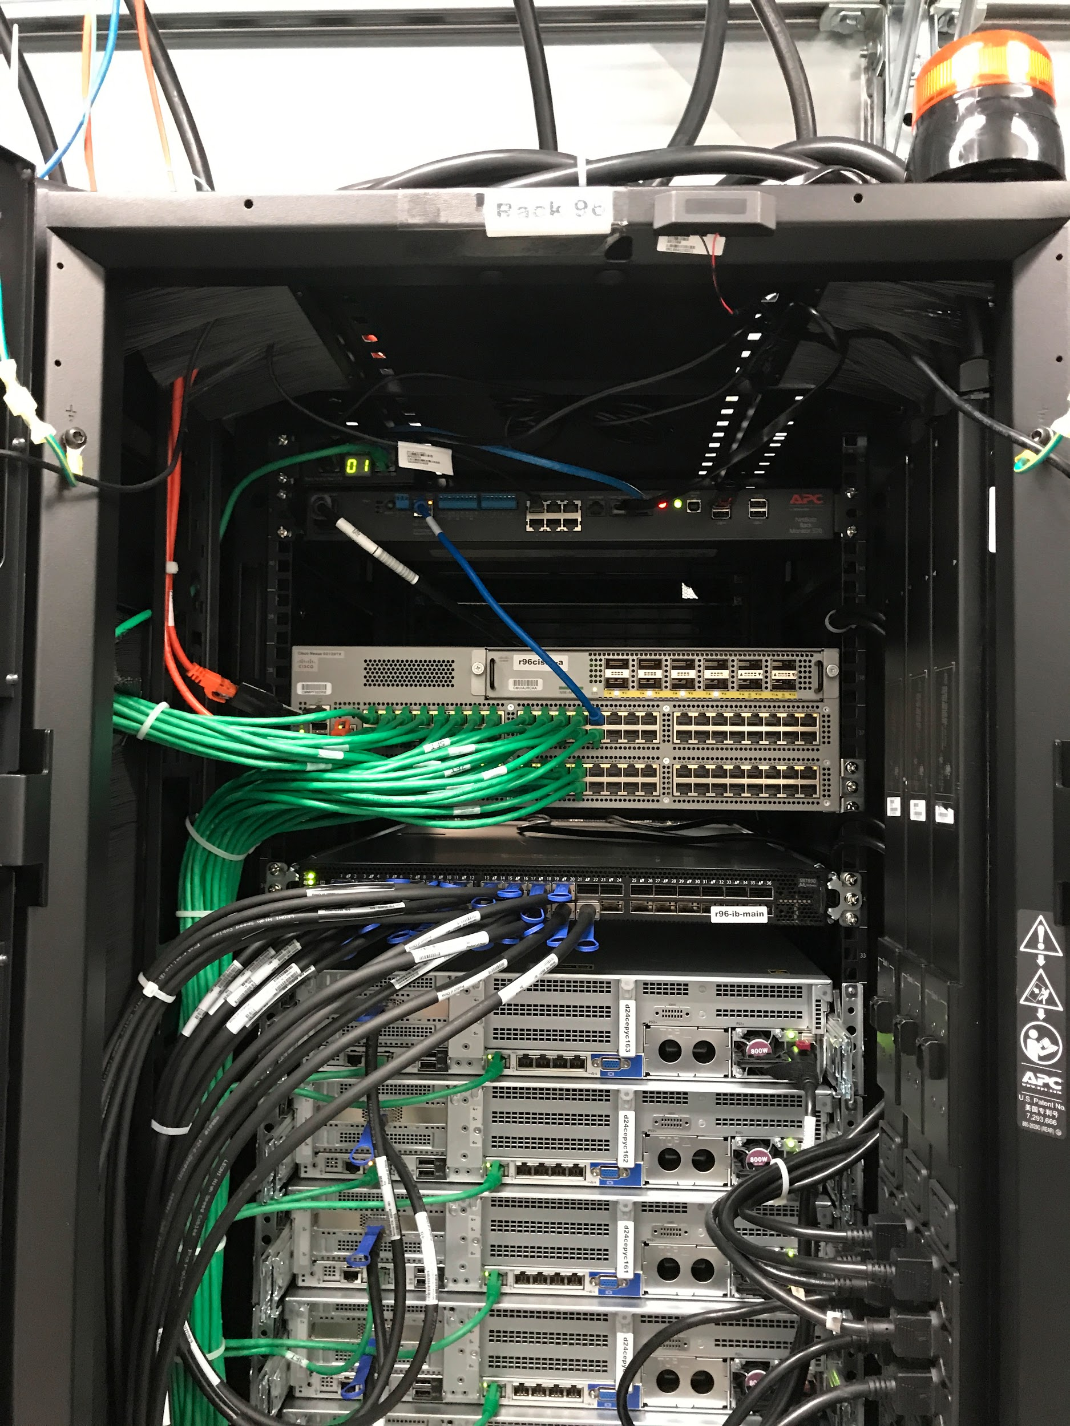
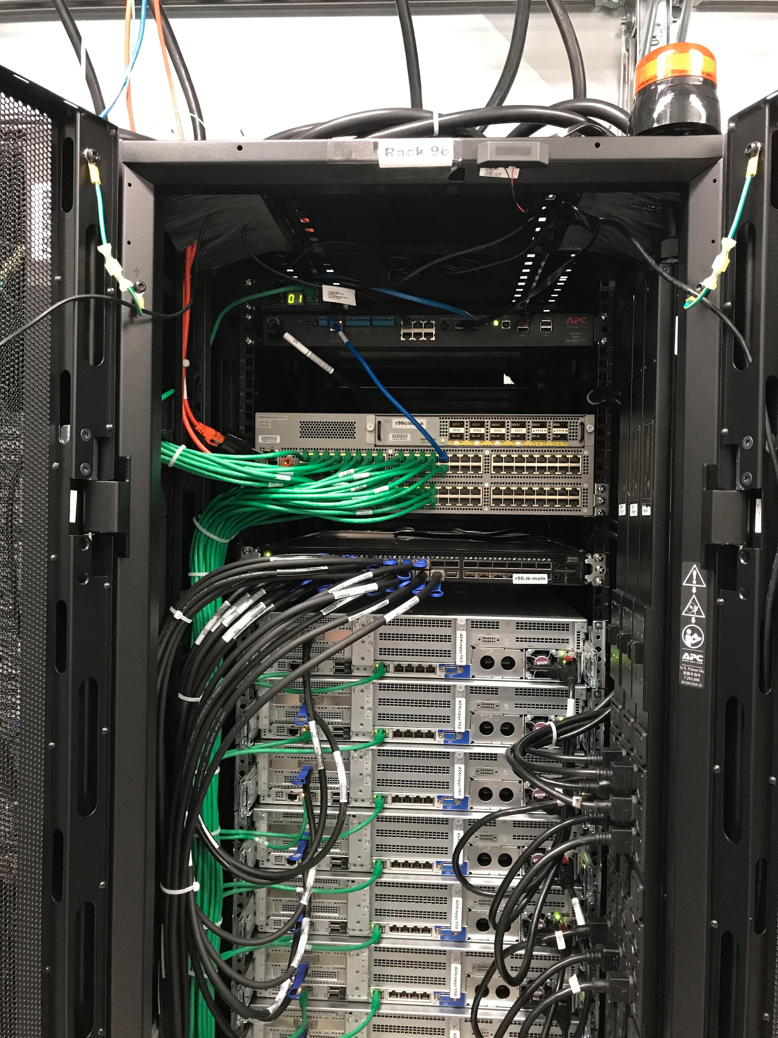
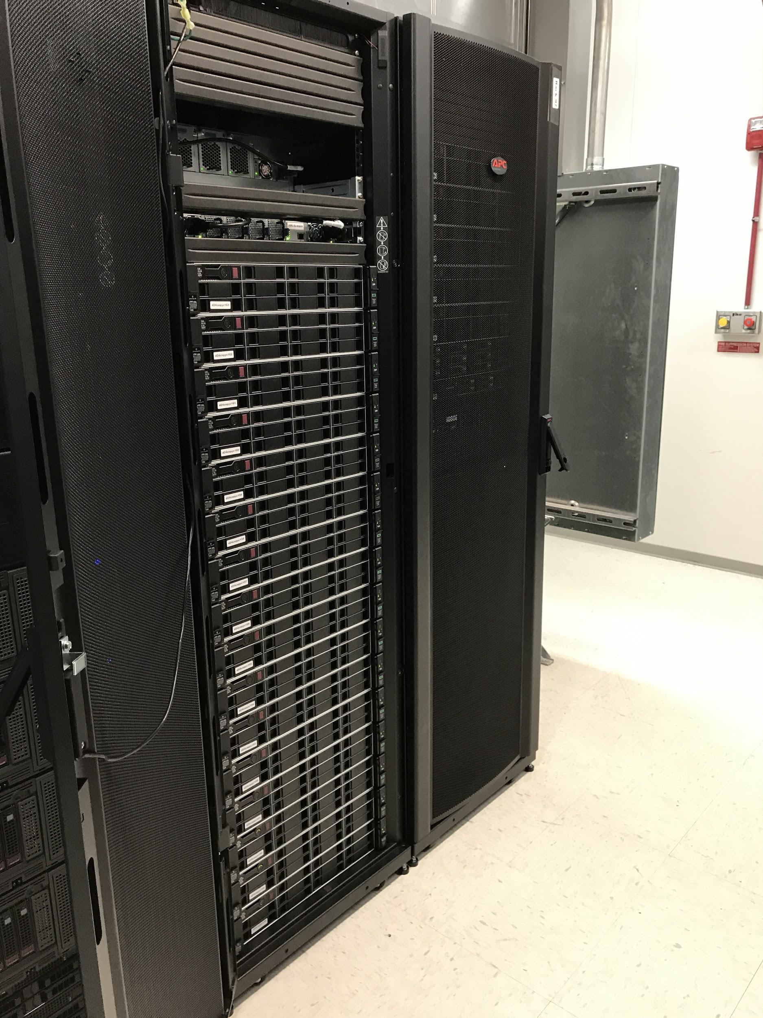
Notes:
point out NetBotz, infiniband, & cisco switches

Slide 16
CUI HPC Infrastructure (cont.)
NFS server for scratch space; persistent data only resides in the AWS GovCloud environment
Separate xCAT server used only for HPC CUI systems
Separate Univa Grid Engine setup for job scheduler
Also includes other administrative/infrastructure services, some to help fulfill CUI requirements
Notes:
Examples: Log aggregation server (Graylog), Tripwire change monitoring service, etc.

Slide 17
Campus Bridge
On-campus HPC and GovCloud CUI environments connected via multiple encrypted tunnels
Using a Cisco ASR network appliance
Two tunnels: between Shared Services VPC and on-campus HPC and between NDTL project VPC and on-campus HPC
Only path to access on-campus CUI HPC environment over the network

Slide 18
Questions?

